Slide 1

Sorting Algorithms Bubble Sort, Selection Sort & Insertion Sort
CSA0624 – Design and Analysis of Algorithm
Presented by:
ROSHAN K
192425014
SuperviseD by:
Dr. Gnanajeyaraman Rajaram

Slide 2
Objective
Understand three basic sorting algorithms.
Learn their working principles.
Compare their time complexities and applications.

Slide 3
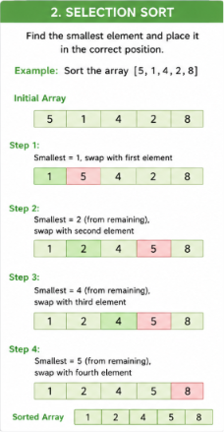
Selection Sort
Finds the smallest element.
Places it in the correct position.
Repeats for the remaining elements.
Performs fewer swaps than Bubble Sort.
Time Complexity
Best Case: O(n²)
Average Case: O(n²)
Worst Case: O(n²)

Slide 4
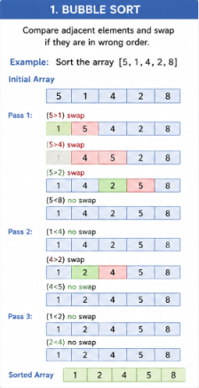
Bubble Sort
Compares adjacent elements.
Swaps elements if they are in the wrong order.
Repeats until the array is sorted.
Simple but inefficient for large datasets.
Time Complexity
Best Case: O(n)
Average Case: O(n²)
Worst Case: O(n²)

Slide 5
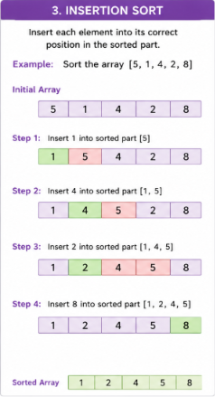
Insertion Sort
Builds a sorted portion one element at a time.
Inserts each new element into its correct position.
Efficient for small or nearly sorted datasets.
Time Complexity
Best Case: O(n)
Average Case: O(n²)
Worst Case: O(n²)

Slide 6
Conclusion
Bubble Sort: Easy to understand but slow.
Selection Sort: Fewer swaps, useful when writes are expensive.
Insertion Sort: Best choice for small or nearly sorted datasets.

